Slide 1
Las Vegas Algorithm
A presentation by Albin, Fredrik R, Fredrik S, Johan, Mikael and Peter Keogh

Slide 2
Outline
What is a randomized algorithm?
The Las Vegas algorithm
Our problem: Sudoku
Solving the Sudoku with Las Vegas
Comparison

Slide 3
What is a randomized algorithm?
Randomizes values instead of using a deterministic approach
Pros:
Can for some problems find a correct answer quicker than a deterministic algorithm
Cons:
Can in the worst case go on forever if no limits are instated

Slide 4
The Las Vegas Algorithm
Randomizes values until a correct solution is found
Will either find a correct solution, or no solution at all
No limits
Can in the worst case run forever

Slide 5
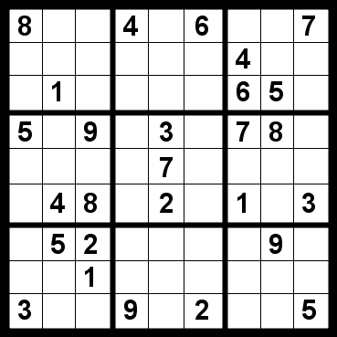
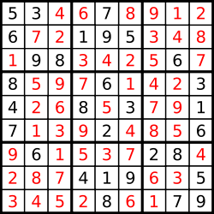
Our problem: Sudoku
How to play
Only one of each number (1-9) on each row
Only one of each number (1-9) on each column
Only one of each number (1-9) in each quadrant

Slide 6
Solving Sudoku with Las Vegas
We built 3 algorithms
1st: Total randomization of coordinates within each quadrant (total restart when invalid coordinates)
2nd: Re-randomize when a field on the board is occupied (Re-randomizing coordinates for a number if the chosen location is occupied)
3rd: Randomize coordinates only among valid locations

Slide 7
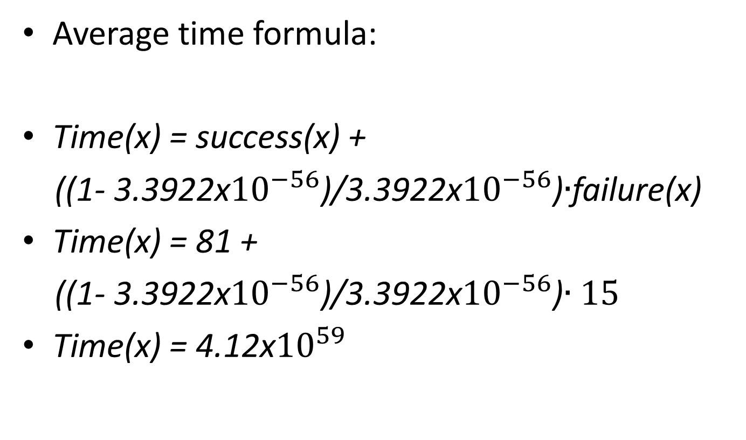
Result
Average time formula:
Time(x) = success(x) +
((1- 3.3922x${10}^{−56}$)/3.3922x${10}^{−56}$)$∙$failure(x)
Time(x) = 81 +
((1- 3.3922x${10}^{−56}$)/3.3922x${10}^{−56}$)$∙15$
Time(x) = 4.12x${10}^{59}$

Slide 8
Results
2x2 Board (Smaller Sudoku board)
1st:
Average Time To Solve: 11 seconds
Average Amount of Restarts: 27 844 275
2nd:
Average Time To Solve: 1,5 milliseconds
Average Amount of Restarts: 1100
3rd
Average Time To Solve: 1 milliseconds
Average Amount of Restarts: 1

Slide 9
Results
3x3 Board (The usual Sudoku board size)
1st:
Average Time To Solve: Never finished
Average Amount of Restarts: -
2nd:
Average Time To Solve: Never finished
Average Amount of Restarts: -
3rd
Average Time To Solve: 204 milliseconds
Average Amount of Restarts: 949

Slide 10
Results
4x4 Board
3rd
Average Time To Solve: Never Finishes
Average Amount of Restarts: -

Slide 11
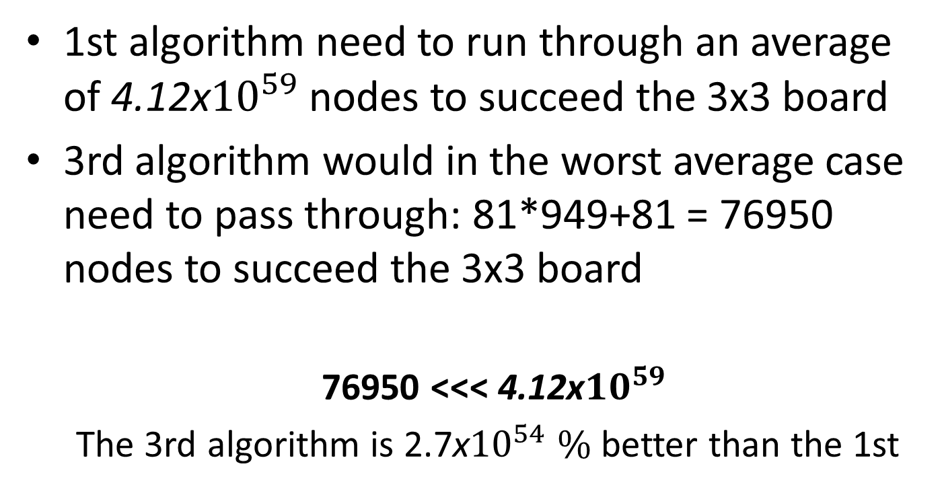
Comparison
1st algorithm need to run through an average of 4.12x${10}^{59}$ nodes to succeed the 3x3 board
3rd algorithm would in the worst average case need to pass through: 81*949+81 = 76950 nodes to succeed the 3x3 board
76950 <<< 4.12x${10}^{59}$
The 3rd algorithm is 2.7x${10}^{54} \%$ better than the 1st

